Slide 1

Under the Esteemed Guidance of: Dr. V. Sujatha Professor
Unified Payment Interface Fraud Detection using Feed Forward Neural Network
Presented By:
Ch. Vineela (21NN1A05D7)
V. Eshitha Reddy (21NN1A05J3)
P. Thulasi (21NN1A05G9)
S. Risitha (21NN1A05H4)

Slide 2
INDEX
Abstract
Introduction
Literature Survey
Research Gaps Identified
Proposed Work
System Architecture
Algorithm
Dataset Used
Results and Discussion
Conclusion
References

Slide 3
ABSTRACT
UPI(Unified Payment Interface) payment fraud is a serious threat to financial security, causing enormous financial losses due to fraud or cybercrimes, leading to reduced trust in digital payment systems and online financial transactions.. Fraud detection at the early stage and correctness are necessary to prevent risks and improve transaction security. In this project, a new method for the detection of UPI fraud based on a Feedforward Neural Network (FNN) optimized for real-time analysis has been proposed. Current models, including Convolutional Neural Networks (CNN), LSTM, and GRU, have demonstrated good performance but are challenged by scalability, feature extraction, and detection accuracy. To overcome these shortcomings, we introduce a FNN-based model that benefits from efficient feature learning, which lowers computational expense while enhancing fraud detection accuracy. The introduced model attains a 92% accuracy, which surpasses current models like CNN (83%), LSTM(75%), and GRU (79%). The model is integrated into an easy-to-use interface via Streamlit.

Slide 4
INTRODUCTION
Digital payments now form a ubiquitous part of economic transactions, UPI (Unified Payments Interface) being used popularly for convenience and ease of use. At the same time, the rise in UPI transactions has correspondingly increased financial frauds posing a serious challenge to financial safety.
Real-time detection of fraudulent transactions is required to prevent monetary losses and ensure trust in electronic payments.
Real-time fraudulent transactions detection is required to prevent money losses and ensure confidence in electronic transactions.
Conventional fraud detection techniques, including rule-based systems and manual checks, are labor-intensive, inefficient, and vulnerable to false positives, resulting in delays in fraud prevention.

Slide 5

Fig.1 UPI Payments

Slide 6
LITERATURE SURVEY
S.NO | Author & year | Technologies Used | Advantages | Limitations
1 | Rashid et al., (2024) | Artificial Neural Networks (ANNs) | ANNs can detect fraudulent transactions efficiently by understanding complex fraud patterns. They become more accurate as they process more transaction information over time, hence applicable for adaptive fraud methods. | The primary limitation of ANNs is their reliance on large volumes of labeled training data. Additionally, they require significant computational power, making real-time fraud detection costly.

Slide 7
S.No | Author and Year | Techniques Used | Advantages | Limitations
2 | Mishra et al., (2024) | Deep Neural Network (DNN) | DNNs enhance fraud detection by identifying non-linear relationships in transaction data. They outperform traditional fraud detection methods by minimizing false positives and improving prediction reliability. | Although more accurate, DNNs are computationally expensive and require frequent retraining to keep up with new labels, making implementation complex.

Slide 8
S.No | Author and Year | Techniques Used | Advantages | Limitations
3 | Joseph et al.,(2024) | Long Short-Term Memory (LSTM) | LSTMs effectively process sequential transaction information,detecting suspicious behavior over time. | LSTM Requires significant training time and computational resources, limiting real-time performance.

Slide 9
S.No | Author and Year | Techniques Used | Advantages | Limitations
4 | Bodade et al.,(2023) | Hybrid Deep Learning Model (LSTM + SVM + Random Forest) | Hybrid models improve the accuracy of fraud detection through a combination of deep learning and classical ML methods. | Higher complexity in model creates higher computational demands and maintenance issues.

Slide 10
S.No | Author and Year | Techniques Used | Advantages | Limitations
5 | Kumar et al., (2020) | Convolutional Neural Networks (CNNs) | CNNs extract features automatically, minimizing the need for feature engineering and enhancing detection efficiency. | This model can be less efficient for sequential transaction data than models such as RNNs or LSTMs.

Slide 11
RESEARCH GAPS IDENTIFIED
Existing deep learning architectures require extensive computational resources, making real-time fraud detection challenging, especially in large-scale financial systems with high transaction volumes.
Machine learning models often have high latency, making it difficult to provide instant transaction verification, which is crucial for preventing unauthorized payments.
Deep learning approaches require large labeled datasets. When trained on imbalanced fraud datasets, they may struggle with overfitting and fail to generalize to emerging fraud patterns.
Models may fail to capture subtle anomalies in fraudulent transaction behaviors, leading to misclassification in cases where fraudulent and legitimate transactions appear similar.

Slide 12
PROPOSED WORK
Feedforward Neural Networks (FNNs) are lightweight and efficient, making them well-suited for deployment in real-time UPI fraud detection systems with minimal computational resources.
FNNs provide faster inference compared to complex deep learning models, enabling quick transaction verification, which is crucial for preventing fraudulent payments in real-time.
FNNs can be easily adapted and fine-tuned for fraud detection tasks by leveraging transaction-specific features such as transaction amount, frequency, device ID, and location, improving model performance even with limited labeled fraud data.
FNNs offer scalability, allowing the model to be adjusted based on the complexity of transaction patterns, making it adaptable for various financial fraud detection scenarios, from small-scale banking applications to large-scale UPI networks.
FNNs are highly interpretable compared to deep learning models like CNNs,GRUs and LSTMs, making it easier for financial institutions to understand fraud detection decisions and comply with regulatory requirements.

Slide 13
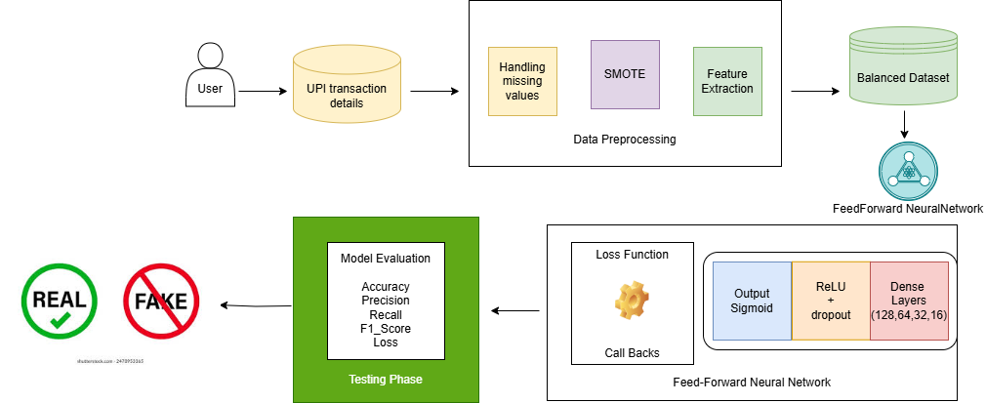
SYSTEM ARCHITECTURE

Slide 14
ALGORITHM
Algorithm: UPI Payment Fraud Detection using FNN
Input: UPI transaction dataset
Output: Fraud or Non-Fraud classification
Preprocess the dataset
Handle missing values(Drop rows with excessive missing data or impute missing values.)
Normalize numerical features(Standardize or normalize continuous variables ), Encode categorical features( Use Label Encoding )
For each epoch:
Perform forward propagation through input and hidden layers
Compute activations using ReLU or Sigmoid functions
Compute loss using cross-entropy
Update weights using backpropagation
End of for loop
Evaluate the model
Use the test dataset to assess model performance
Calculate accuracy based on predictions vs actual labels

Slide 15
DATASET USED
Dataset name: UPI Fraud Dataset
Source: Available in open datasets(eg : kaggle)
Preprocessing: Handling missing values, normalization, categorical encoding, outlier detection
Total Transactions: 10000
Transactions after augmentation: 18000
Number of Labels : 2(Fraud or not Fraud)
Data Set link :" https://www.kaggle.com/datasets/iamravi11/fraud-upi-transaction-details "

Slide 16
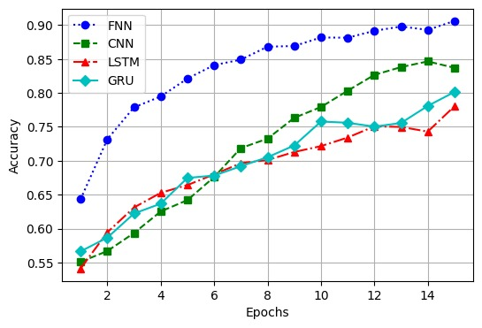
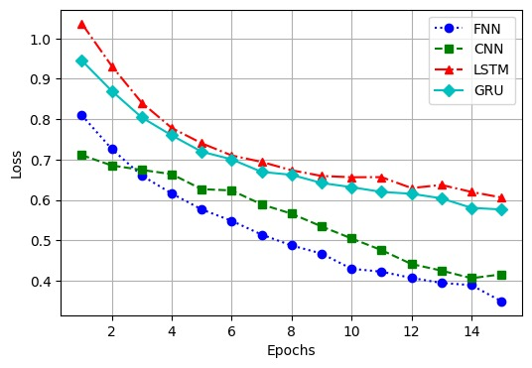
RESULTS
Fig 1: Accuracy
Fig 2: Loss

Slide 17
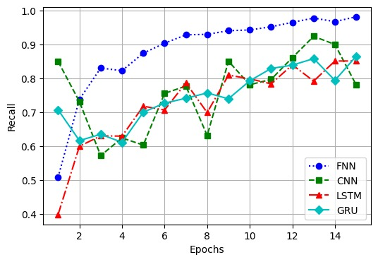
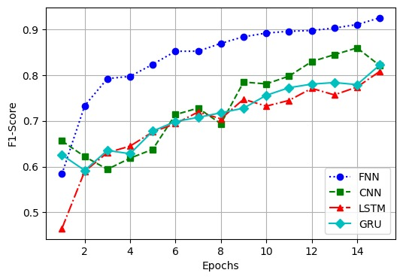
Fig 3: Recall
Fig 4: F1_Score

Slide 18
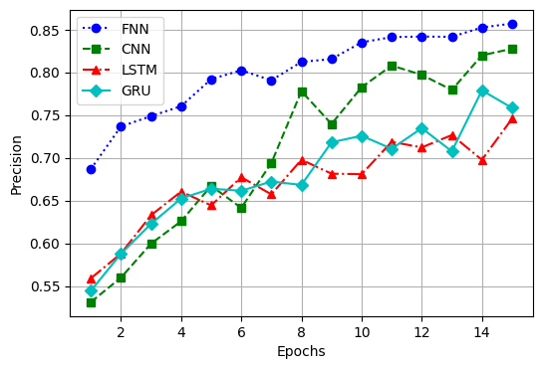
Fig 5: Precision

Slide 19
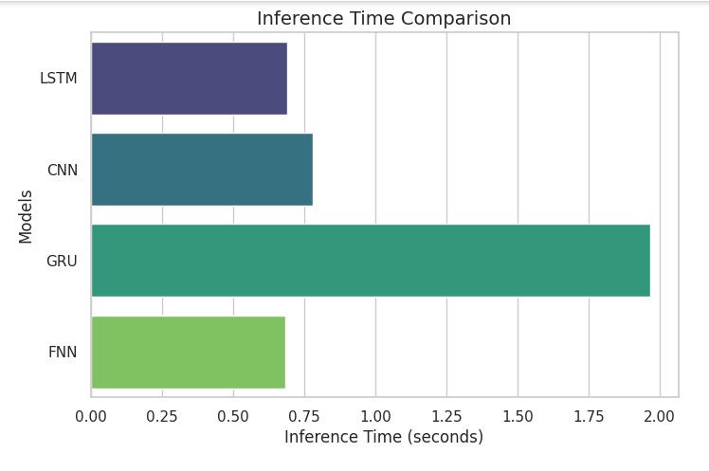
Fig 6: Inference Time

Slide 20
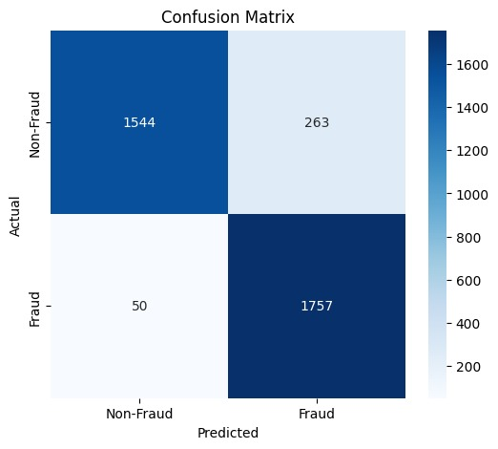
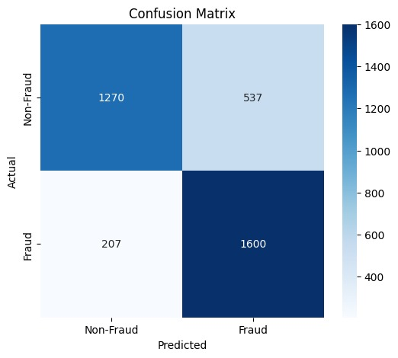
Fig 8(a): FNN Confusion Matrix
Fig 8(b): LSTM Confusion Matrix

Slide 21

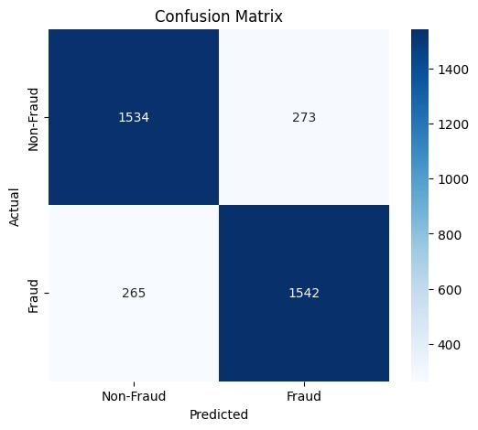
Fig 8(c): CNN Confusion Matrix
Fig 8(d): GRU Confusion Matrix

Slide 22
CONCLUSION
FNN-based UPI Fraud Detection Model minimizes computational complexity for effective real-time fraud detection in financial transactions. Feature selection methods like correlation analysis and recursive feature elimination enhance the performance of the model by extracting important transaction patterns. Combining FNN with real-time financial monitoring systems can further strengthen fraud detection abilities, enabling banks and payment providers to prevent fraudulent transactions proactively. Future studies can enhance the model by adding graph-based transaction analysis, user behavior profiling, and blockchain technology to increase fraud detection accuracy and resistance to changing fraud methods.

Slide 23
REFERENCES
[1] Mishra, A., Patel, D., & Rao, S. (2024). Real-Time UPI Fraud Detection Using Machine Learning. International Journal of Computer Applications, 12(4), 112-118.
[2] Joseph, D. S., Pawar, P. M., & Chakradeo, K. (2024). Web-Based UPI Fraud Detection Using Data Analytics. International Journal of Research in Applied Science and Engineering Technology (IJRASET), 12(8), 302-308.
[3] Bodade, S. S., & Pawade, P. P. (2023). Hybrid Model for UPI Fraud Detection Using Random Forest and SVM. International Journal of Innovative Research in Technology (IJIRT), 8(5), 355-360.
[4] Rashid, R., Aslam, W., & Aziz, R. (2024). Artificial Neural Networks for Detecting UPI Payment Fraud. IEEE International Conference on Cybersecurity (ICCS), 1(2), 44-49
[5] Kumar, A., & Singh, R. (2020). Fraud Detection in UPI Transactions Using Machine Learning. EPRA International Journal of Research and Development (IJRD), 9(5), 127-134.

Slide 24
Thank You

